Slide 1
reference report

Slide 2
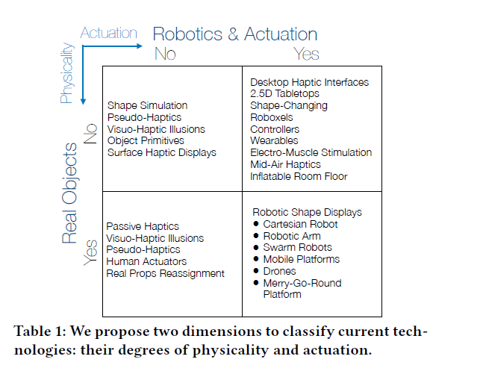
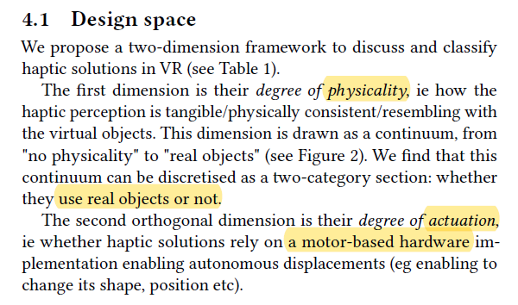
PA model
> “Can I Touch This?”: Survey of Virtual Reality Interactions via Haptic Solutions

Slide 3
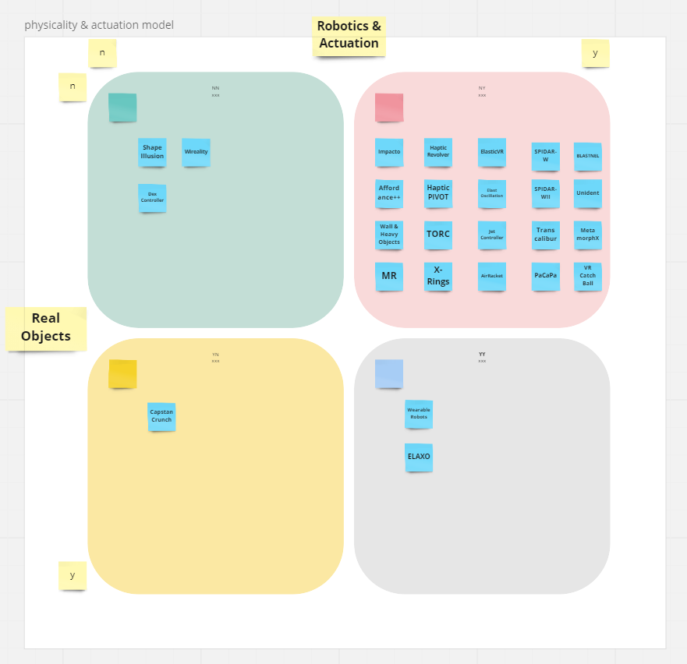
catalog by PA model

Slide 4
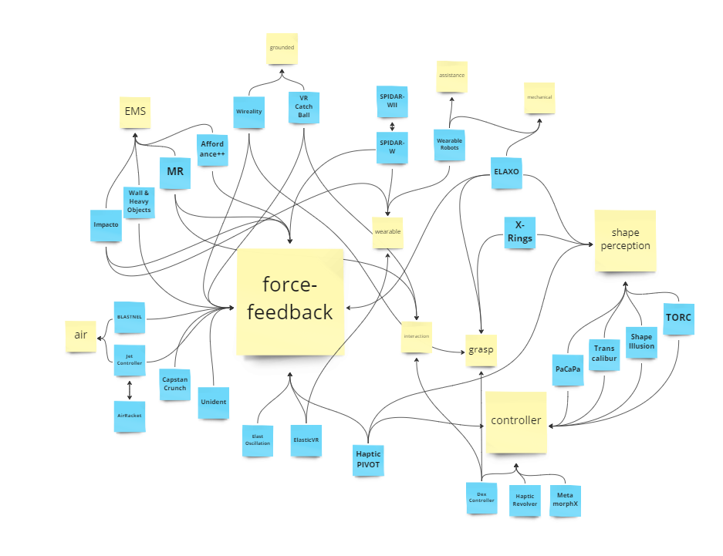
catalog by keywords
criteria：
keyword
abstract & introduction
compared to others
*Not classified to the category when it is not mentioned the concept.

Slide 5
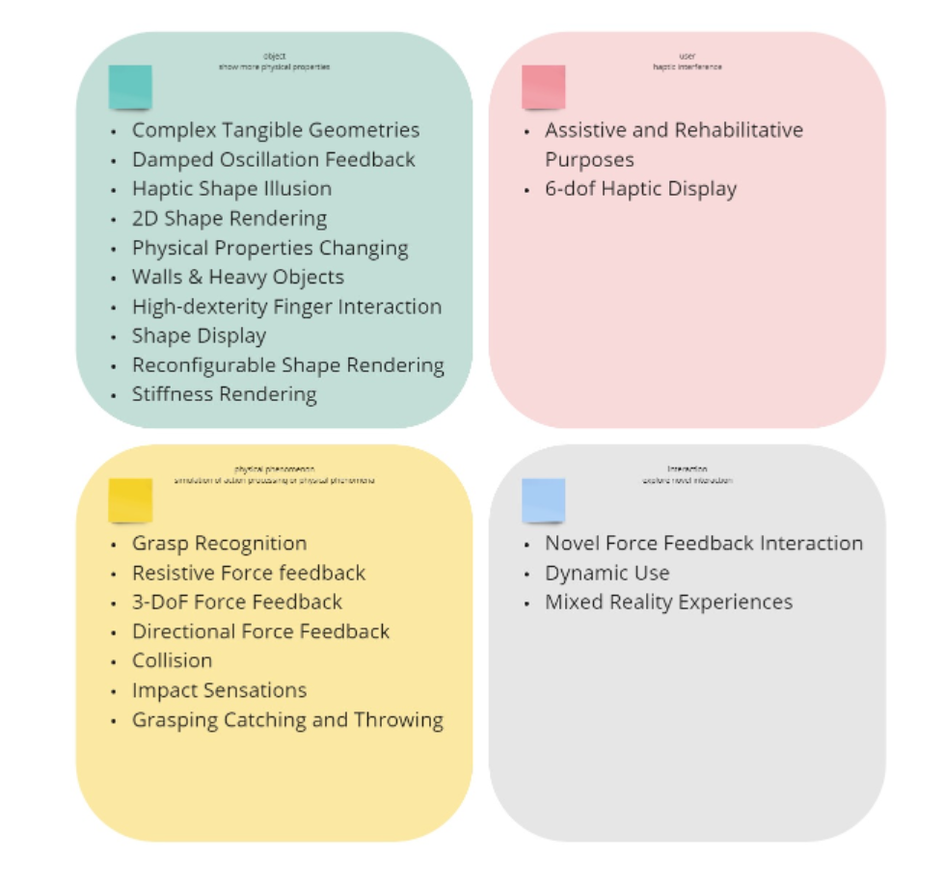
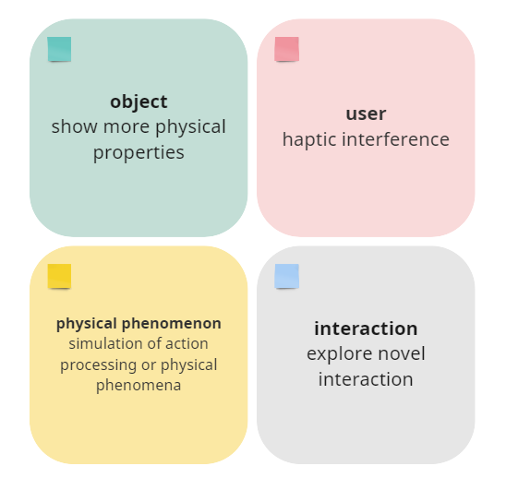
catalog by research object

Slide 6
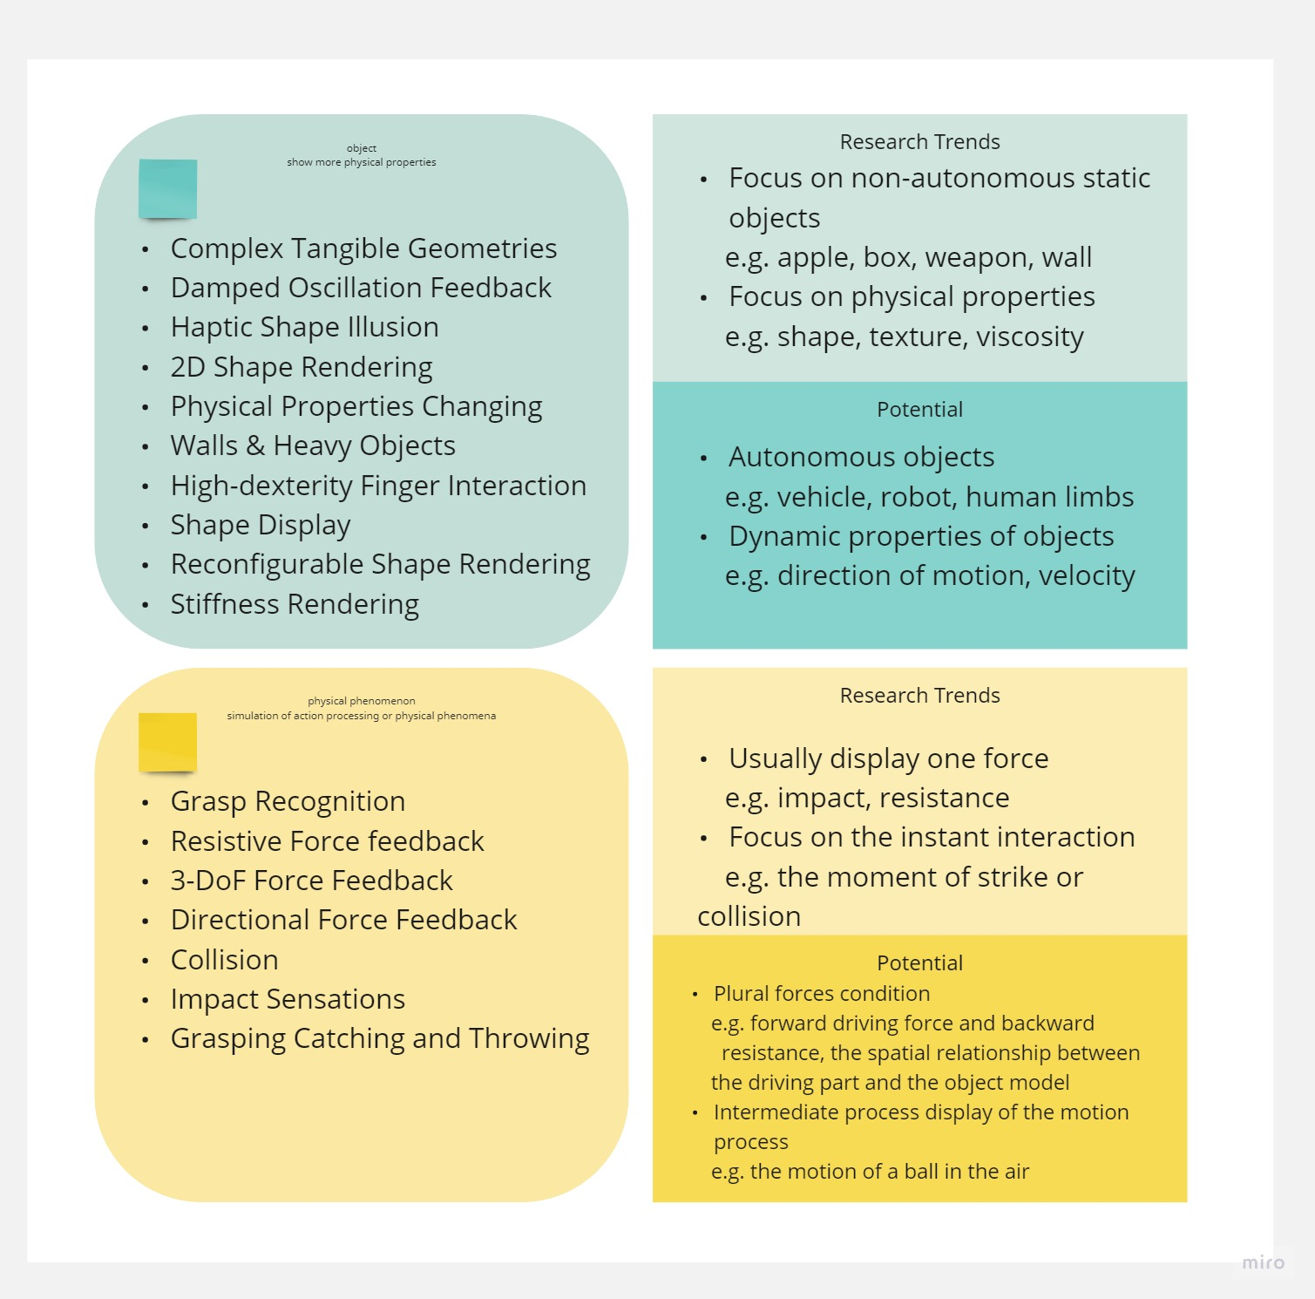
research trends

Slide 7
study case

Slide 8
motion state
no specific definition of motion
avatar target：apartment movement, self movement
object target：motion state, 6 dof info
potential functions: displacement,navigation,locamotion

Slide 9
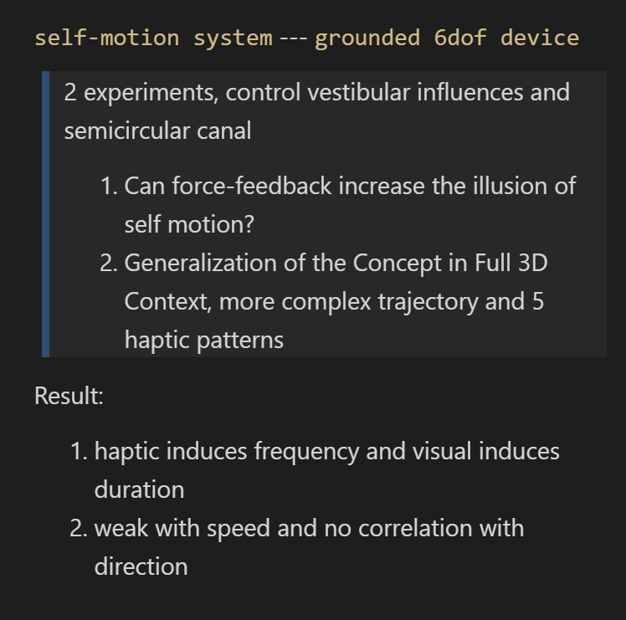
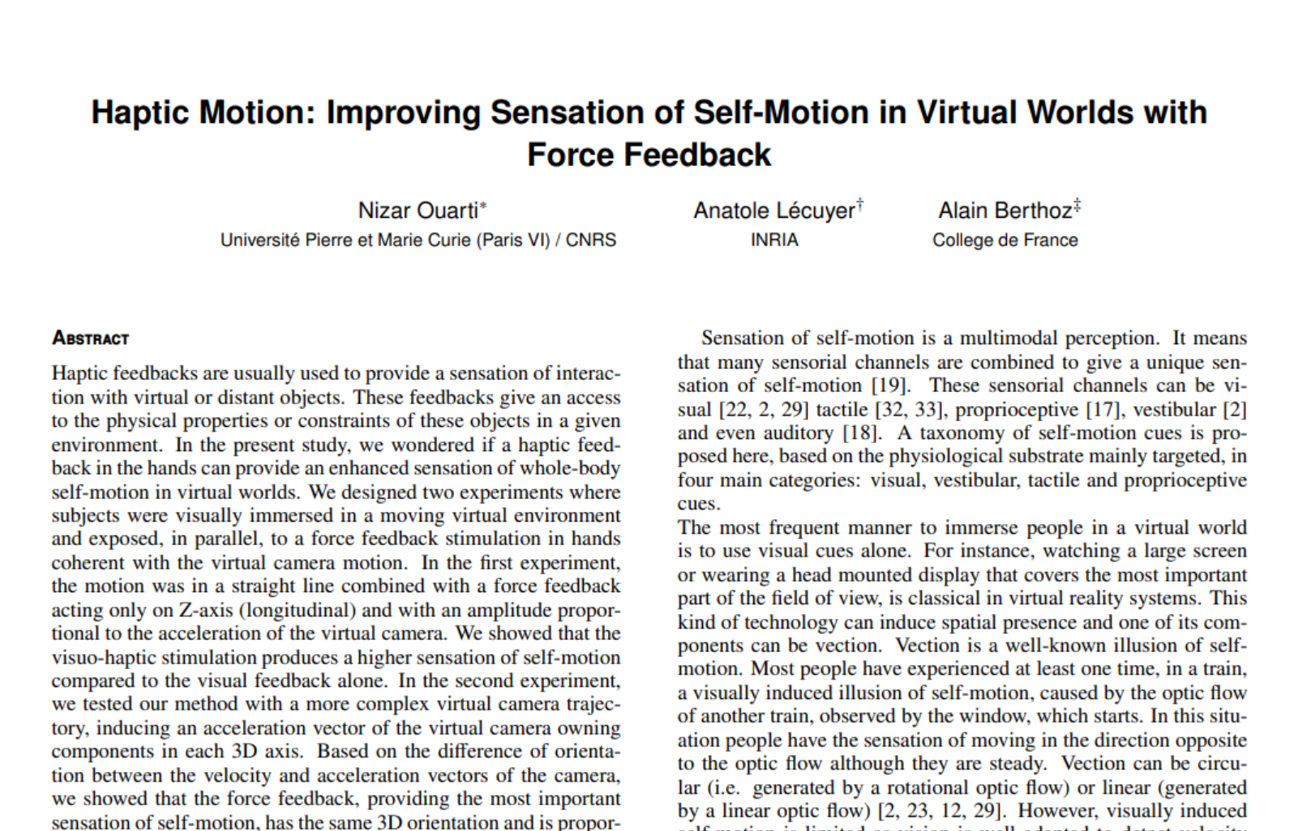
self-motion

Slide 10
abstract report

Slide 11
Research direction
Since the ground-fixed 6DOF device can represent the translation and rotation of a moving object, whether the ungrounded handheld haptic device that can show the same information ?
As such a device does not exist, study from step1, whether the ungrounded handheld haptic device that can show the translation information in 1 Dof.
how to design it and prove it ?

Slide 12
Main testing scenarios
Using Unity and Arduino to create a haptic device that can provide 2 degrees of freedom (2DOF) feedback and apply it to simulate driving. The device will utilize the rotation of servos to express the displacement vectors of the car.

Slide 13
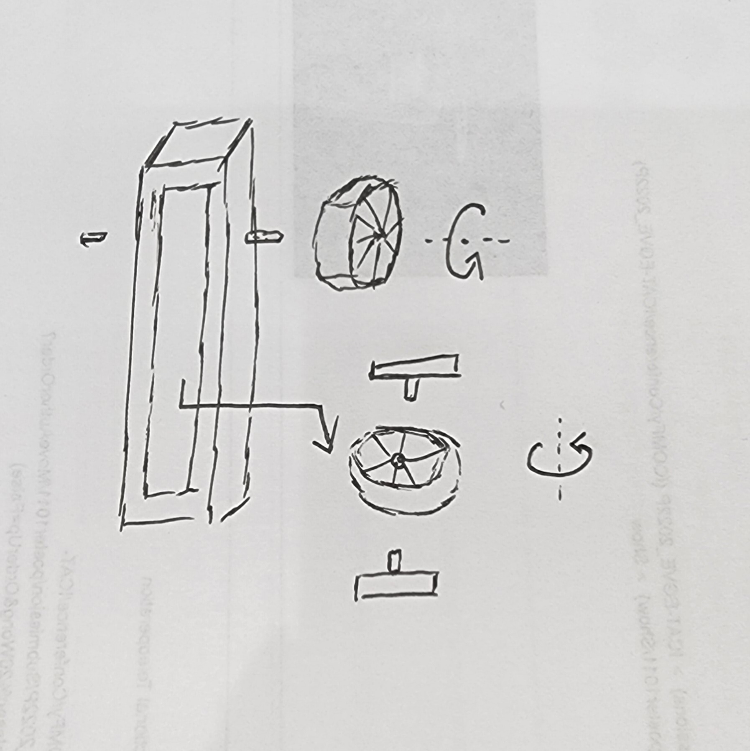
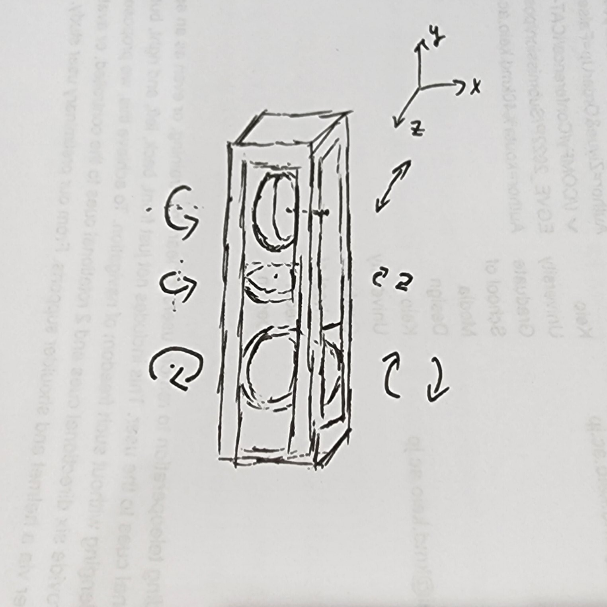
methods-1
Handheld controller, set some belt-winding wheel structure in the center part, and the user can feel the motion state of the object by touching these wheels by hand,the goal is to set 3 wheels to achieve 3dof feedback including front and back, left and right, up and down.
Notes:
design from seniror

Slide 14
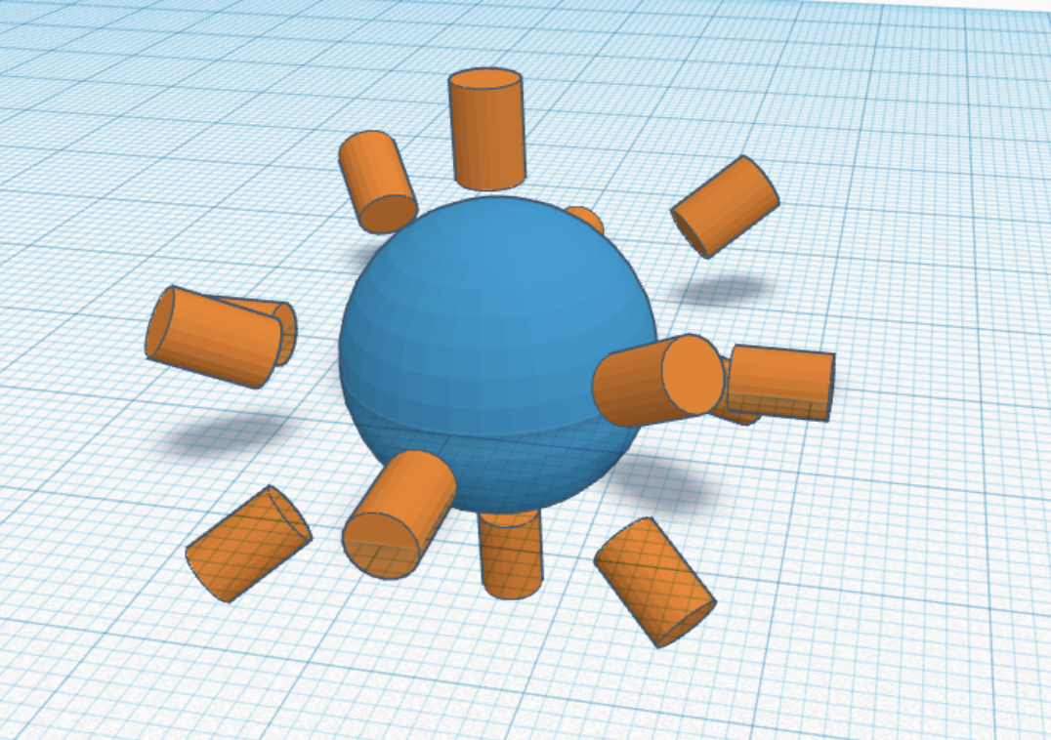
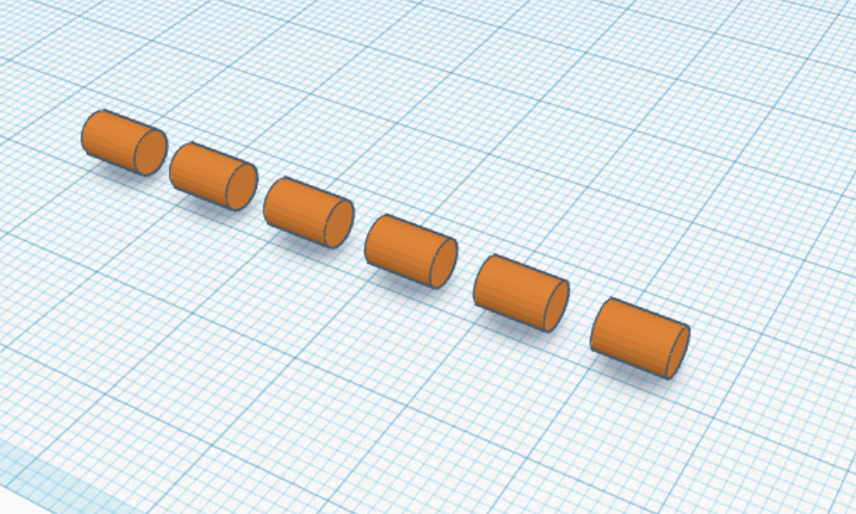
methods-2
A large number of haptic motor are used in superposition, and the full range of feedback or series structure can simulate the whole process of linear motion.

Slide 15
prototype-video

